Slide 1
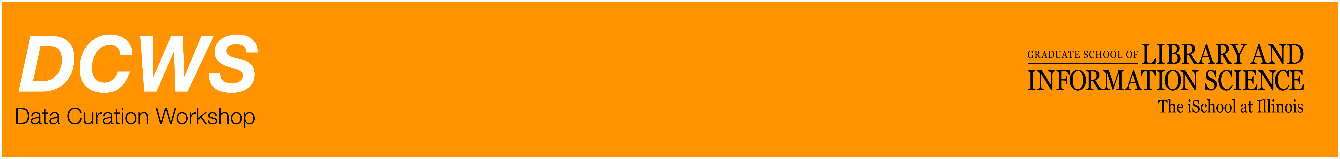
Reference models, lifecycles and workflows: Putting lifecycle models into action

Slide 2
Using lifecycle models as a curatorial tools
We’ll use some of these tools this afternoon in lab
On Wednesday afternoon, I’ll present a case study in which we use workflow documentation (similar to lifecycle modeling) as a curatorial aid

Slide 3
Back to the DCC Lifecycle Model

Slide 4
DCC Checklists
DCC provides checklists for every “sequential” stage of their lifecycle
For example:

Slide 5
Notes:
Broad recommendations, but a good place to start rooting policy development

Slide 7
DCC Checklists
Pros:
Helpful tools to start conversations with your patrons
Great place to start developing policy
Cons:
Advice can be broad

Slide 8
Curation Profiles Project

Slide 9
Curation Profiles Project
IMLS-funded research: Purdue University Libraries and GSLIS
Goal: to understand when researchers were willing to share data, and why
Method: 12 case studies with different research domains
Result:

Slide 10
CPP Case Studies
Agronomy & Soil Science
Anthropology
Biochemistry
Biology
Civil Engineering
Earth & Atmospheric Sciences
Electrical & Computer Engineering
Food Science
Geology
Horticulture & Plant Science
Kinesiology
Speech & Hearing

Slide 11
Curation Profiles Project
Created “Data Curation Profiles” of each domain:
“A Data Curation Profile is essentially an outline of the “story” of a data set or collection, describing its origin and lifecycle within a research project.”
(from http://datacurationprofiles.org)
Notes:
Look at Nic’s slides for this
And

Slide 12
Data Curation Profiles Toolkit
Led to creation of DCP Toolkit: an interview guide and worksheet, to help facilitate conversations between curators and researchers.

Slide 13
** Afternoon Lab **
The Toolkit consists of:
User Guide
Interviewers Manual
Interview Worksheet
The Template

Slide 14
** Afternoon Lab **
The Toolkit consists of:
User Guide
Interviewers Manual
Interview Worksheet
The Template

Slide 15
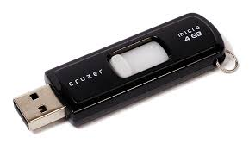
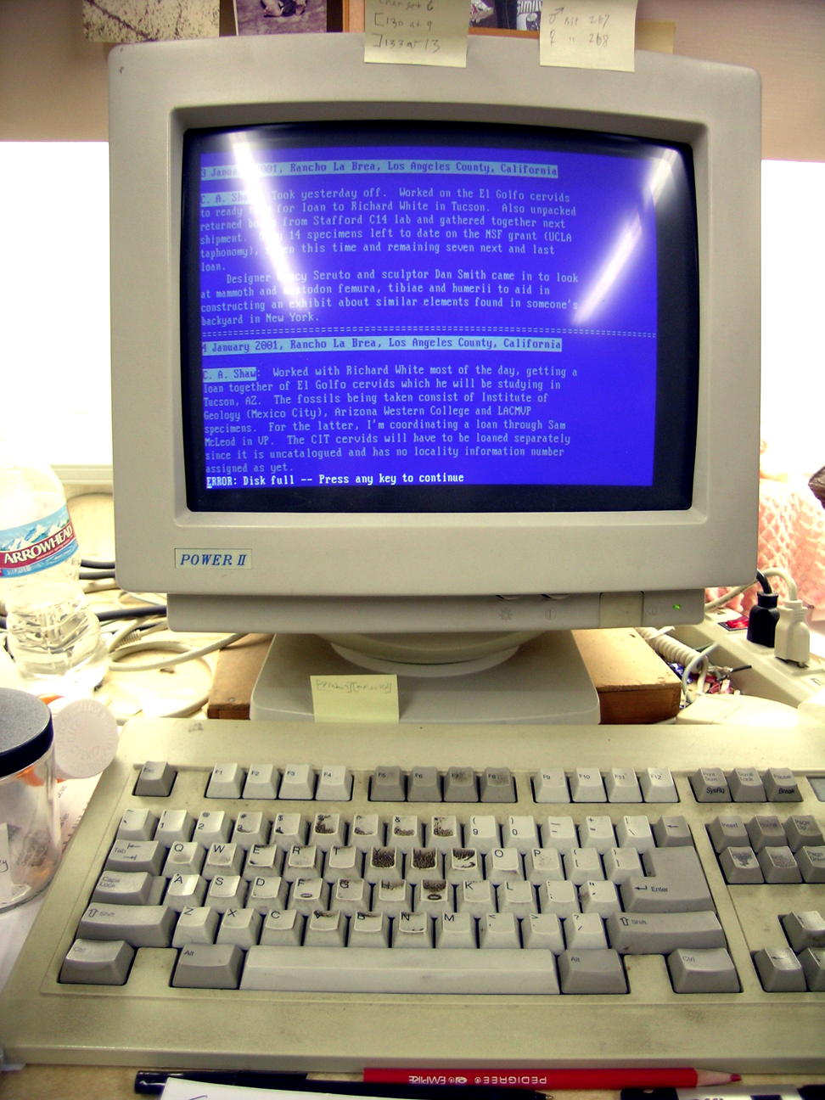
Extrapolating Context
Notes:
Going back to this

Slide 16
** Afternoon Lab **
This afternoon:
We will step through the DCP Toolkit Worksheet
Important to not just use this as a tool, but also analyze its strengths and weaknesses, and adapt as necessary

Slide 17
Data Management Planning Tool

Slide 18
Data Management Planning Overview
A way of pushing curation “upstream” and avoiding loss of context
Required by a growing number of US funding agencies
Good way to begin developing data management policy

Slide 19
DMP Tool
Created by the California Digital Library UC Curation Center
Steps users through a broad range of templates for data management plans
Specific to funding agencies, universities, more

Slide 20
Notes:
Even if you’re not going to be writing data management plans, lots of resources here -

Slide 21
*** Afternoon Lab ***
We’ll step through the DMP Tool and talk about its applicability to your work.

